Slide 1
Answers for the CCHMC
Virtual Sepsis Escape Room

Slide 2
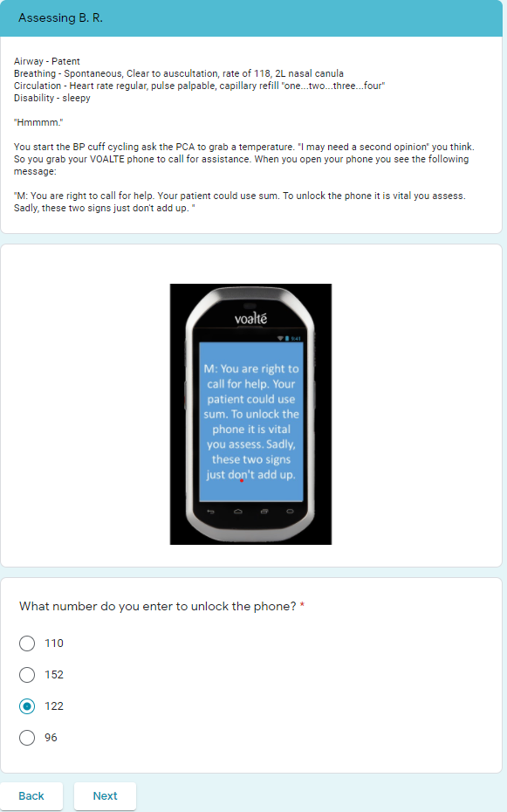
Assessing BR
You recognized that a heart rate of 118 in a 14-year old is not within normal limits. Nor is a capillary refill of 4. And in adding them together to get the code you unlocked the phone.

Slide 3
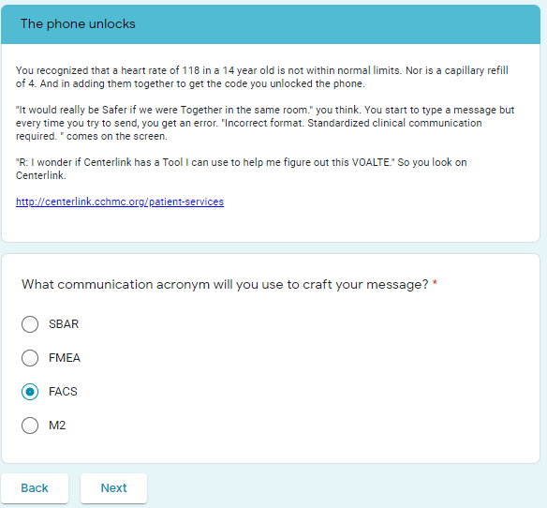
The phone unlocks

Slide 4
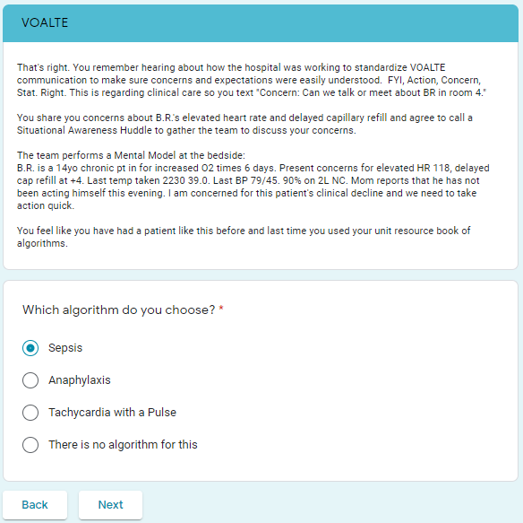
VOALTE

Slide 5
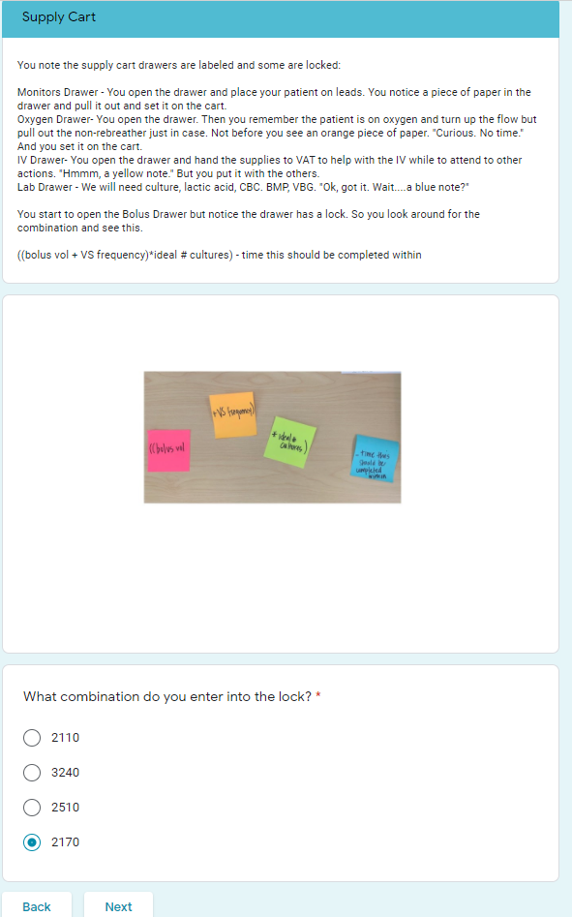
Supply Cart
Bolus volume 54 kg * 20ml/kg = 1080
VS frequency = 15 min
Cultures = 2
Completed in – 20 min
((1080+15) *2) – 20 = 2170

Slide 6
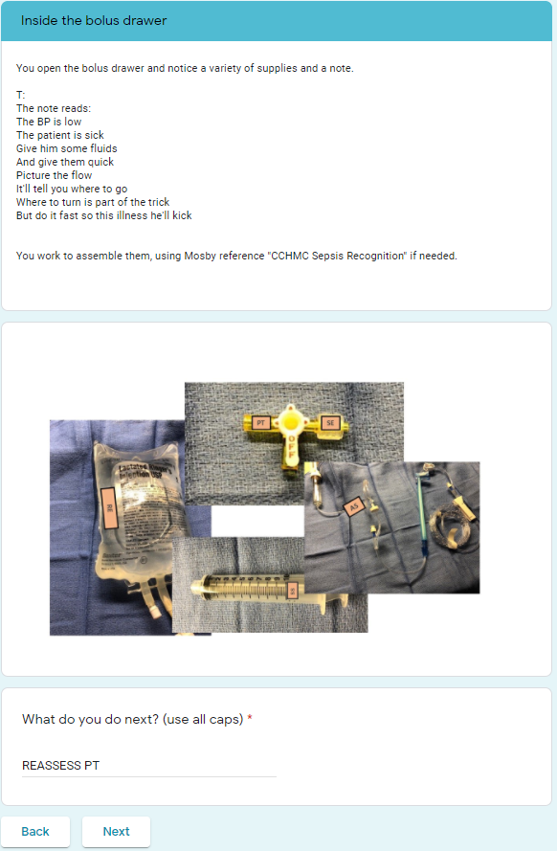
Inside the bolus drawer
This was probably the most confusing of the answers. The letters on the stopcocks spell out the answer (REASSESS PT). Many who took it weren’t quite sure what we were looking for.

Slide 7
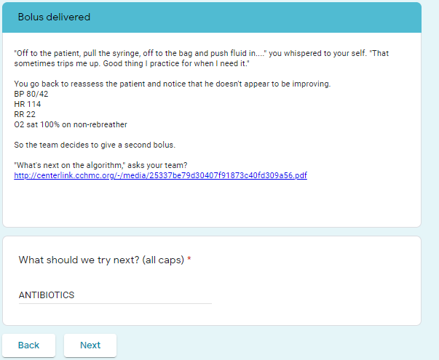
Bolus Delivered

Slide 8
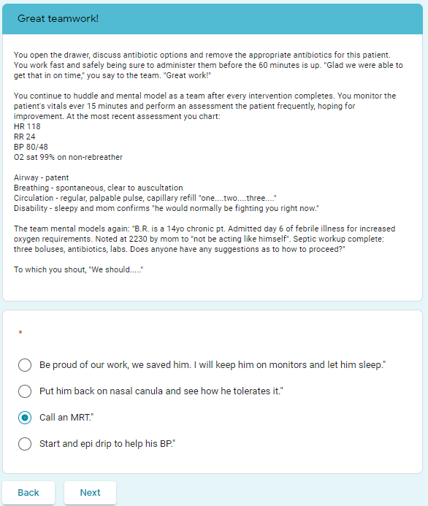
Inside the bolus drawer
MRT is our Medical Response Team made up of RN/RT/MD/APRN from the PICU who respond to situations on the floors when there is a concern about patient decompensation or clinical concerns that require a second opinion

